Slide 1




PS02 : Drift-Sense: AI-Powered Navigation-Error Recovery for Wafer Inspection Tools
SOLUTION :
Drift-Sense locates a high-resolution semiconductor reference pattern inside a larger, noisier search image and predicts its centre coordinates using both classical computer vision and deep learning.
Team Details
Team Name:
The Nanoscale Collective
SR. NO
ROLE
NAME
ACADEMIC YEAR
1
Team Leader
Pratyush Khodade
3rd Year
2
Member 1
Prasad V. Sonar
3rd Year
3
Member 2
Sunny Nigam
2nd Year
4
Member 3
Dhoni Prajapati
3rd Year
COLLEGE NAME
D Y PATIL INTERNATIONAL UNIVERSITY, PUNE
TEAM LEADER CONTACT NUMBER
TEAM LEADER EMAIL ADDRESS
+91 92255 21503
20241404026@dypiu.ac.in

Slide 2
Problem Understanding and Navigation-Error Context
The Problem :
Input Specification :
A semiconductor inspection system must determine where a small reference region exists inside a much larger search image.
| Reference Image : 1000 x 1000 px
| Search Image : 1000 x 1000 px
| Search Image ⁓ 10× larger physical field of view
| Reference Image = shrunk 1/10th inside the search image
Why is this Difficult ?
| DRAM and Fin-FET Layouts are highly repetitive.
| A search region can contain many visually similar candidates:
:: Correct pattern ≠ only visually similar pattern
| Therefore, a model can confidently select the wrong repeated tile.
Ideal Target
Actual Landing
Reference Site
Missed
Core Challenge :
Navigation error is not simply a pixel-level positioning problem -- it can become a fundamental pattern-identification problem.
Motion Stage

Slide 3
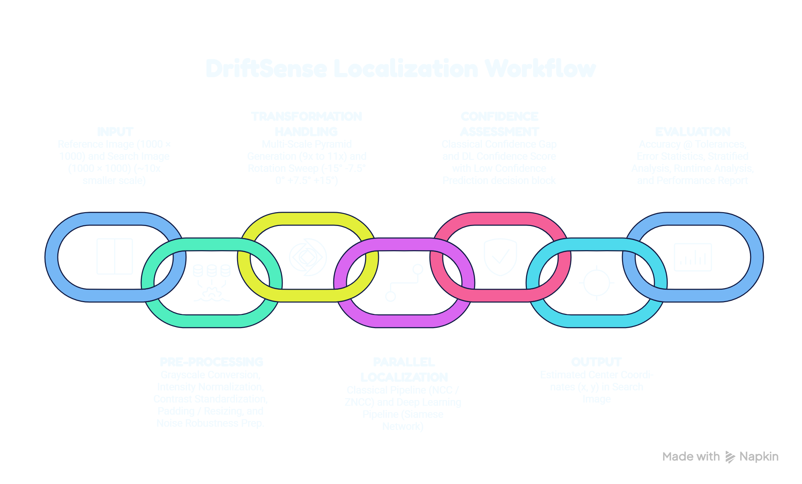
Proposed End-to-End Workflow
( ±3-4° )

Slide 4
DRAM/Fin-FET Synthetic Data Design
Why Synthetic Data ?
The problem requires realistic semiconductor structures while avoiding dependence on confidential fab data.
DRAM Style Structures :
Important innovation: Gap-collapse defect injection
| Periodic horizontal word lines
| Vertical bit lines
| Contact/via structures at intersections
| Dense repeated geometry
| Adjacent DRAM lines / Fin-FET fins can be partially fused to deliberately break perfect periodicity. collapse_prob = 0.12
| This reduced the ambiguity between repeated tiles and became the single largest accuracy improvement.
| Classical accuracy increased from approximately 1–5% → 17.5–24% @5px, a 5–8× improvement from defect injection alone.
Fin-FET Style Structures :
| Dense parallel fin lines
| Horizontal gate structures
| Repetitive nanoscale geometry
Canonical Datasets :
| 800 reference/search pairs | Defect injection
| Full degradation set | Variable scale: 9×–11×
| Seed = 2026

Slide 5

Noise, Blur, Scale & Rotation Modelling with Citations
References & Citations
Sensor Noise — Poisson-Gaussian Signal-Dependent Model DOI : https://doi.org/10.1109/TIP.2008.2001399
SEM Charging Artifacts DOI : https://doi.org/10.1063/1.336493
DRAM / Fin-FET Pitch and Structure Scaling DOI : https://irds.ieee.org/images/files/pdf/2023/2023IRDS_MET.pdf
Wafer Stage Drift and Overlay Error DOI : https://doi.org/10.1117/12.2045715
Key physical model :
| For Poisson-Gaussian noise: σ(x) = √(a·x + b)
This models noise as dependent on the underlying signal instead of using only constant additive Gaussian noise.
Important scope limitation :
Astigmatism and spot-size blur are not separately modelled as distinct physical effects; they are represented through the general blur model.
This is explicitly documented as a scope decision rather than being claimed as full physical modelling.

Slide 6
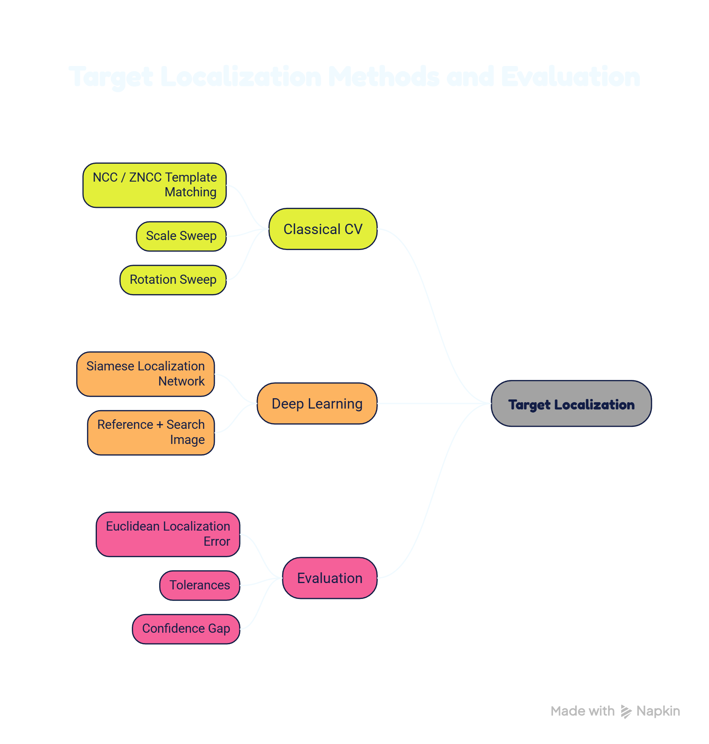
Localization Method and Decision Rule
Decision Rule in Classical CV Approach :
Select the candidate with the highest-quality match score (within 90% of the global best), then use spatial proximity as the tiebreak.
Decision Rule in DL Approach :
For prediction (xₚ,yₚ) and ground truth (xg,yg):
Localization error e = √[(xₚ − xg)² + (yₚ − yg)²]
A prediction is counted as correct when:
e ≤ chosen tolerance

Slide 7
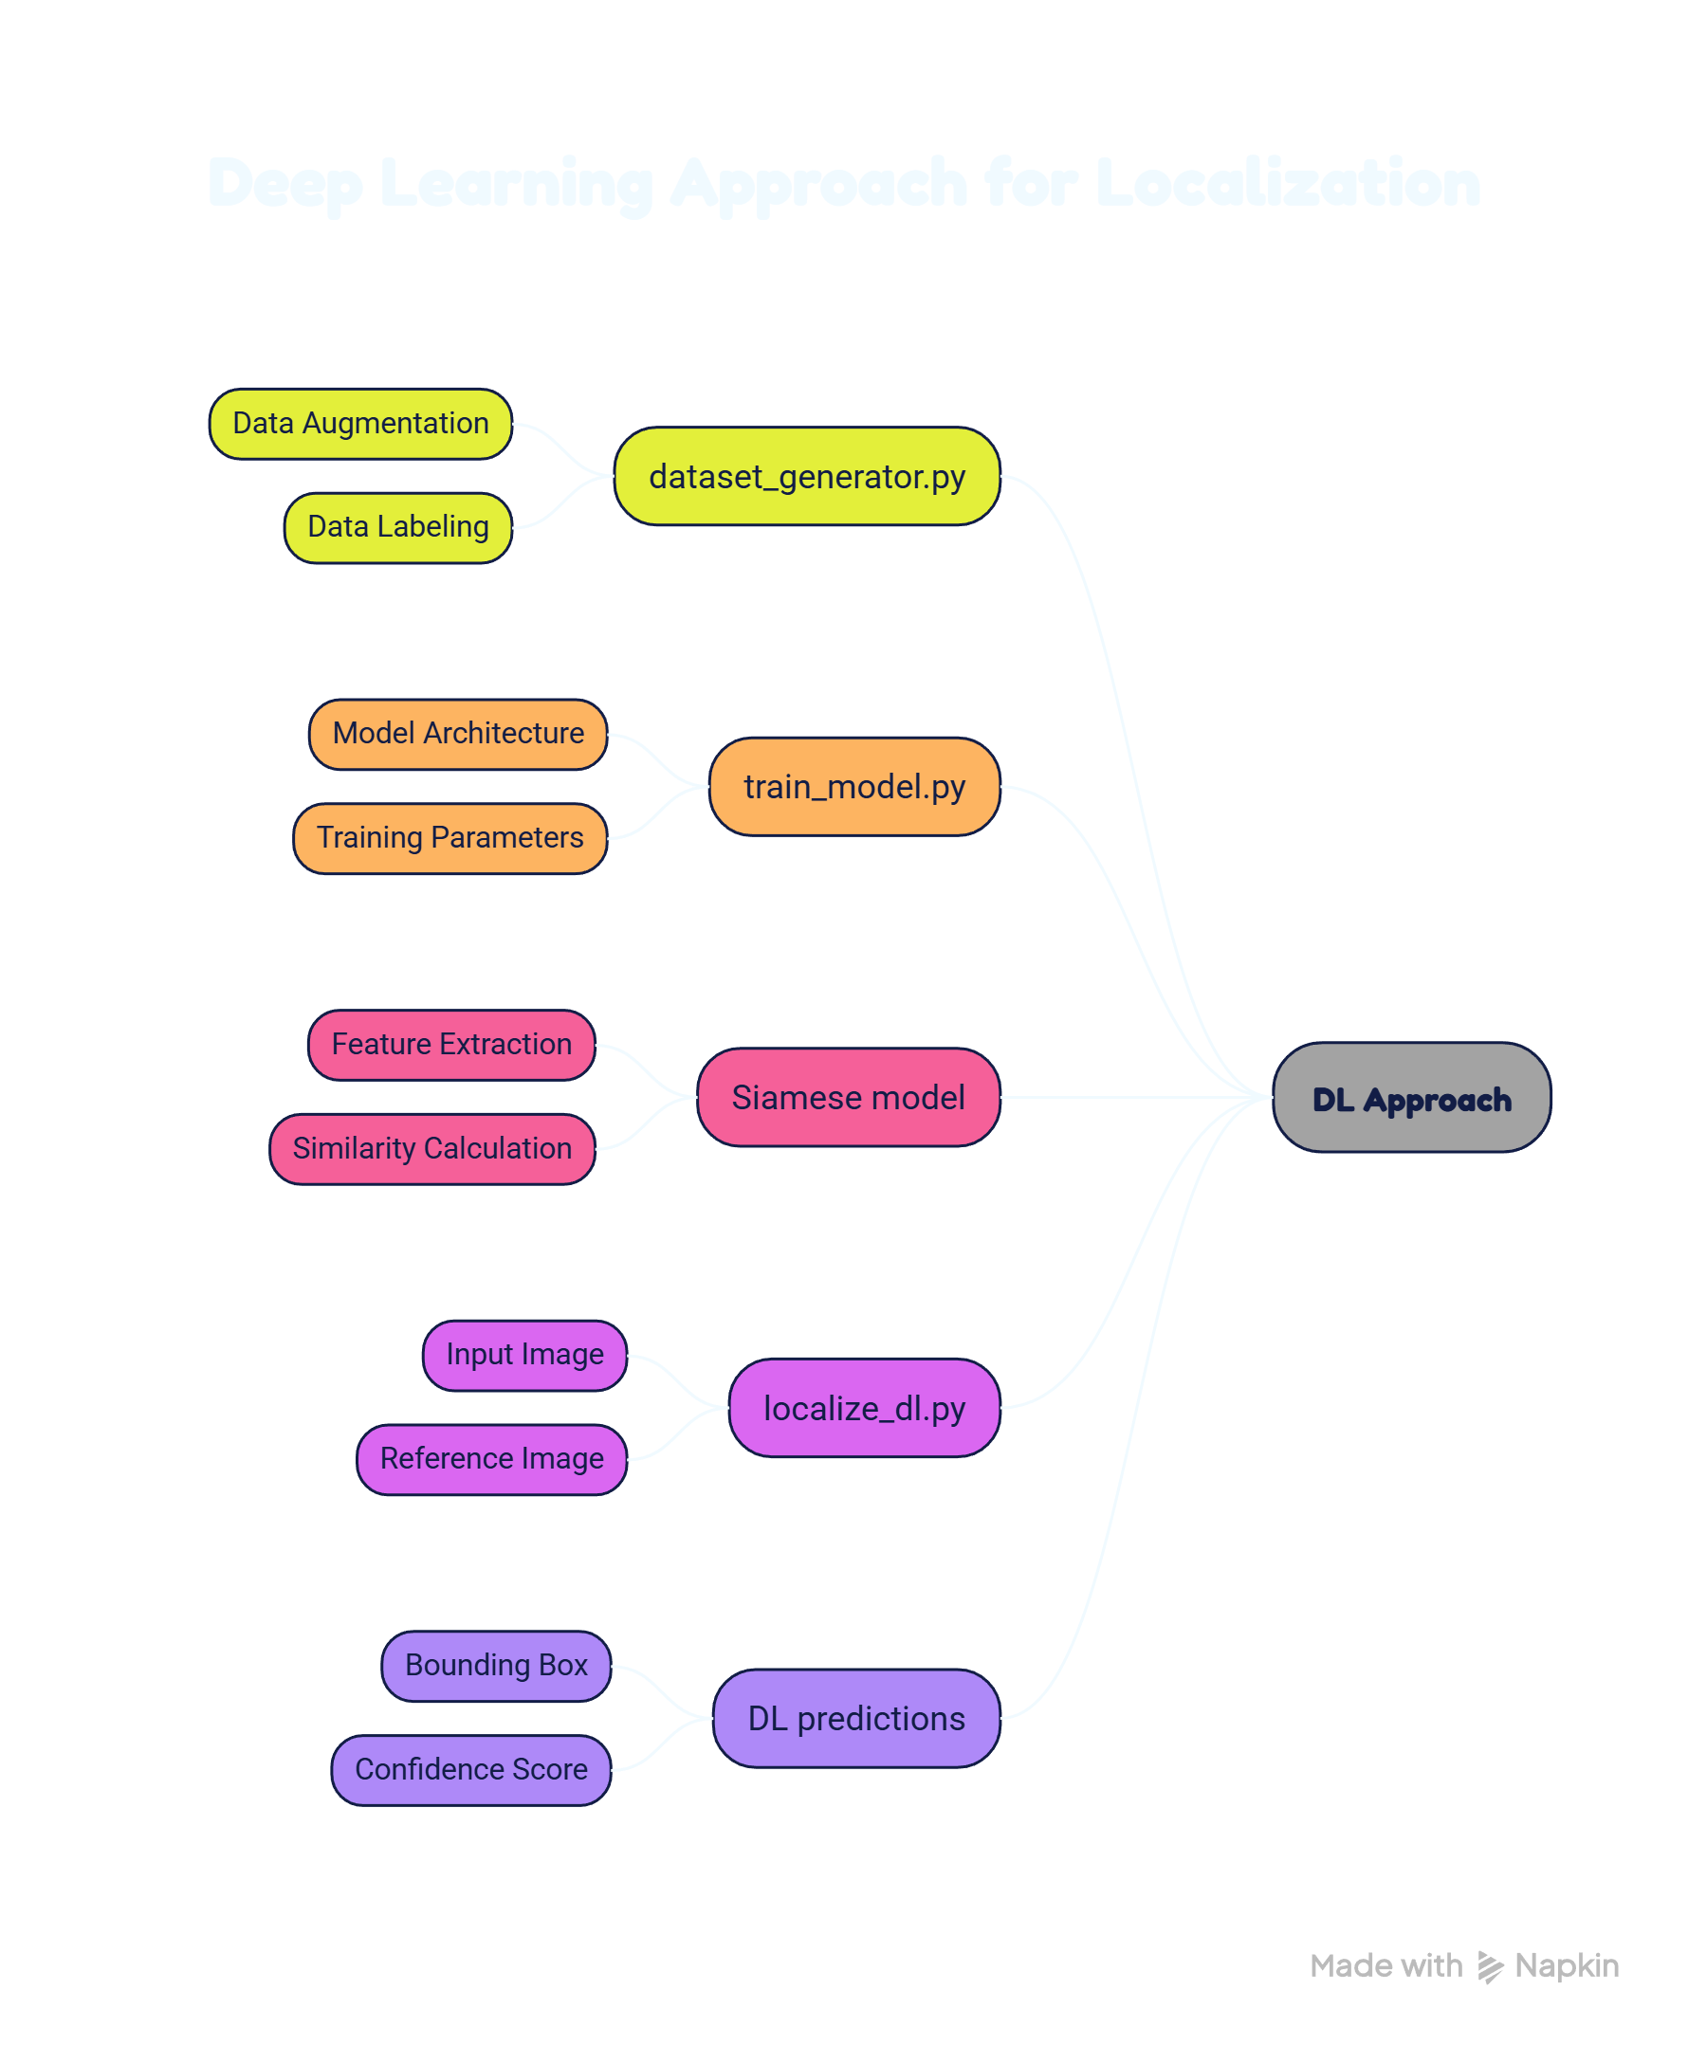
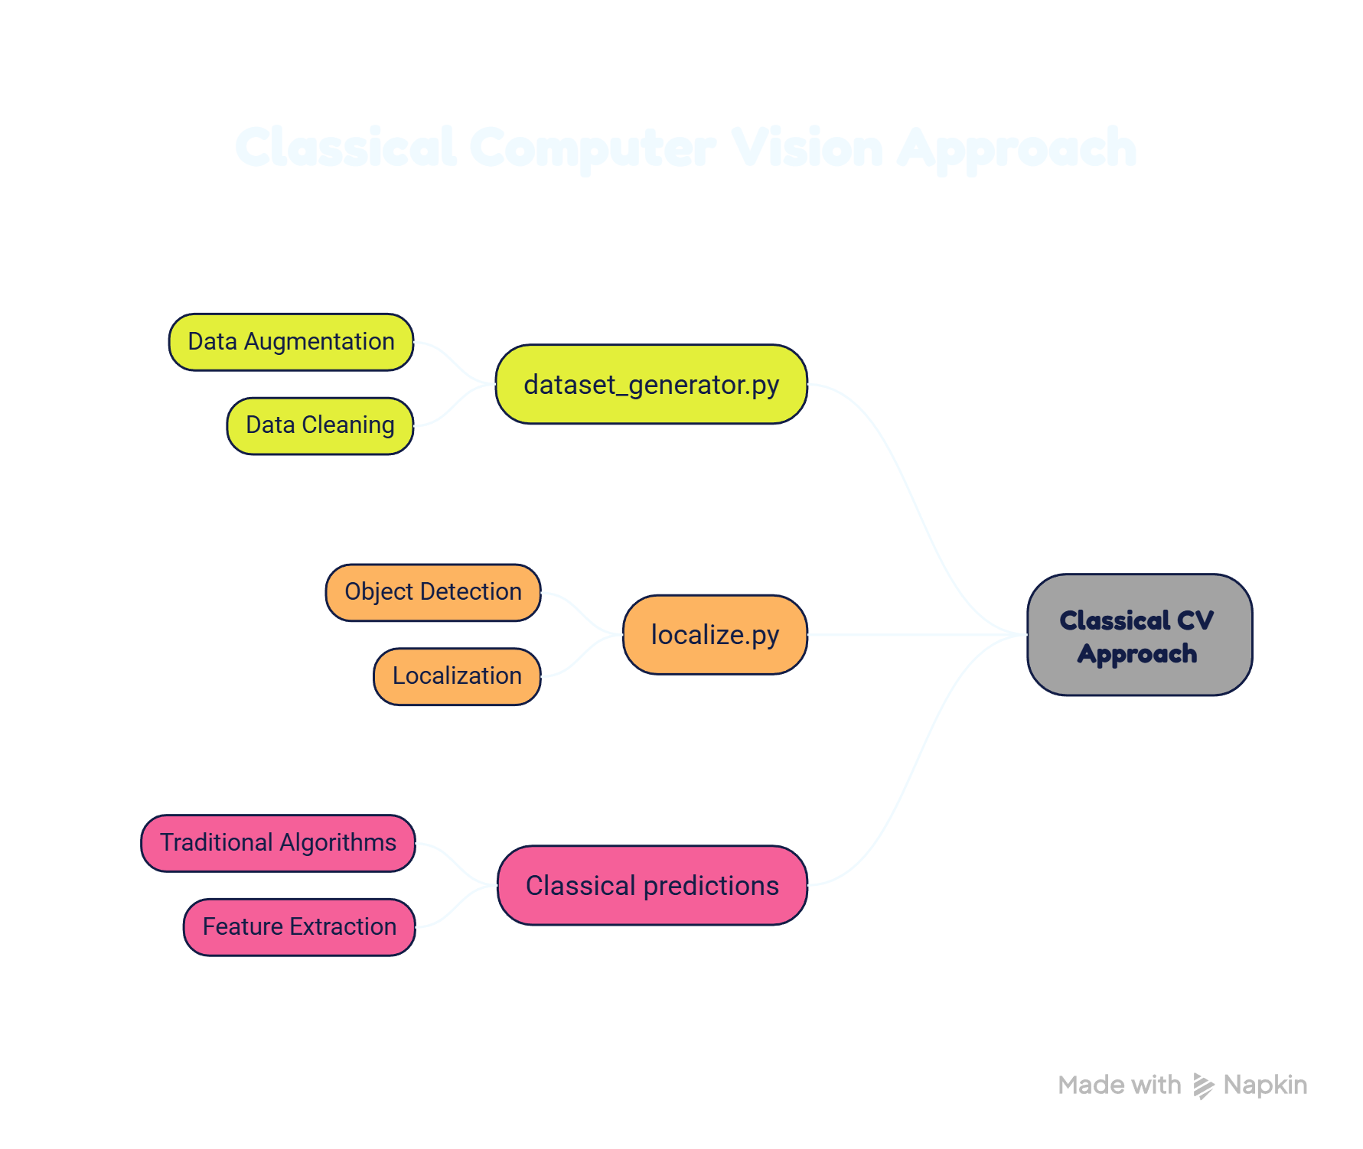
Implementation and Execution Commands
Execution Commands for Classical CV Pipeline :
python evaluate.py \
--manifest data/train_canonical/manifest.csv \
--csv-out results/predictions.csv
Execution Commands for DL Pipeline :
python evaluate_dl.py \
--manifest data/train_canonical/manifest.csv \
--csv-out results/predictions_dl.csv
Execution Commands for Merging the Results :
python merge_results.py \
--manifest data/train_canonical/manifest.csv \
--classical results/predictions.csv \
--dl results/predictions_dl.csv \
--out results/full_results.csv
Confidence Analysis :
python pr_curve.py

Slide 8
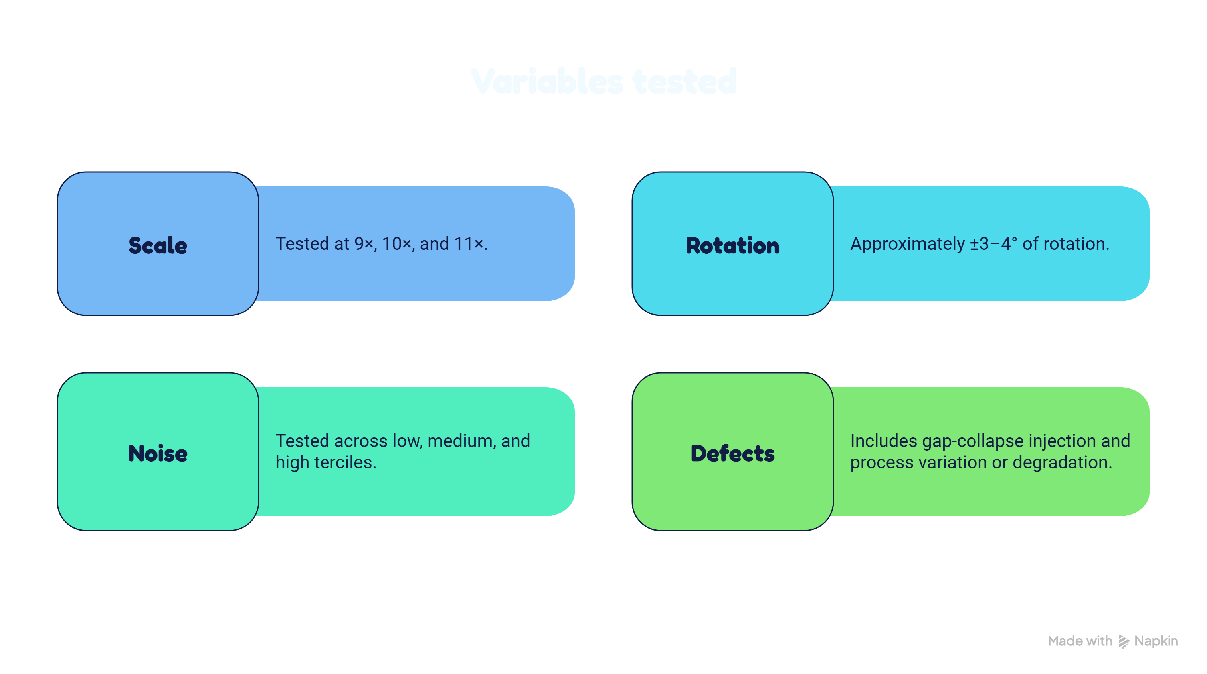
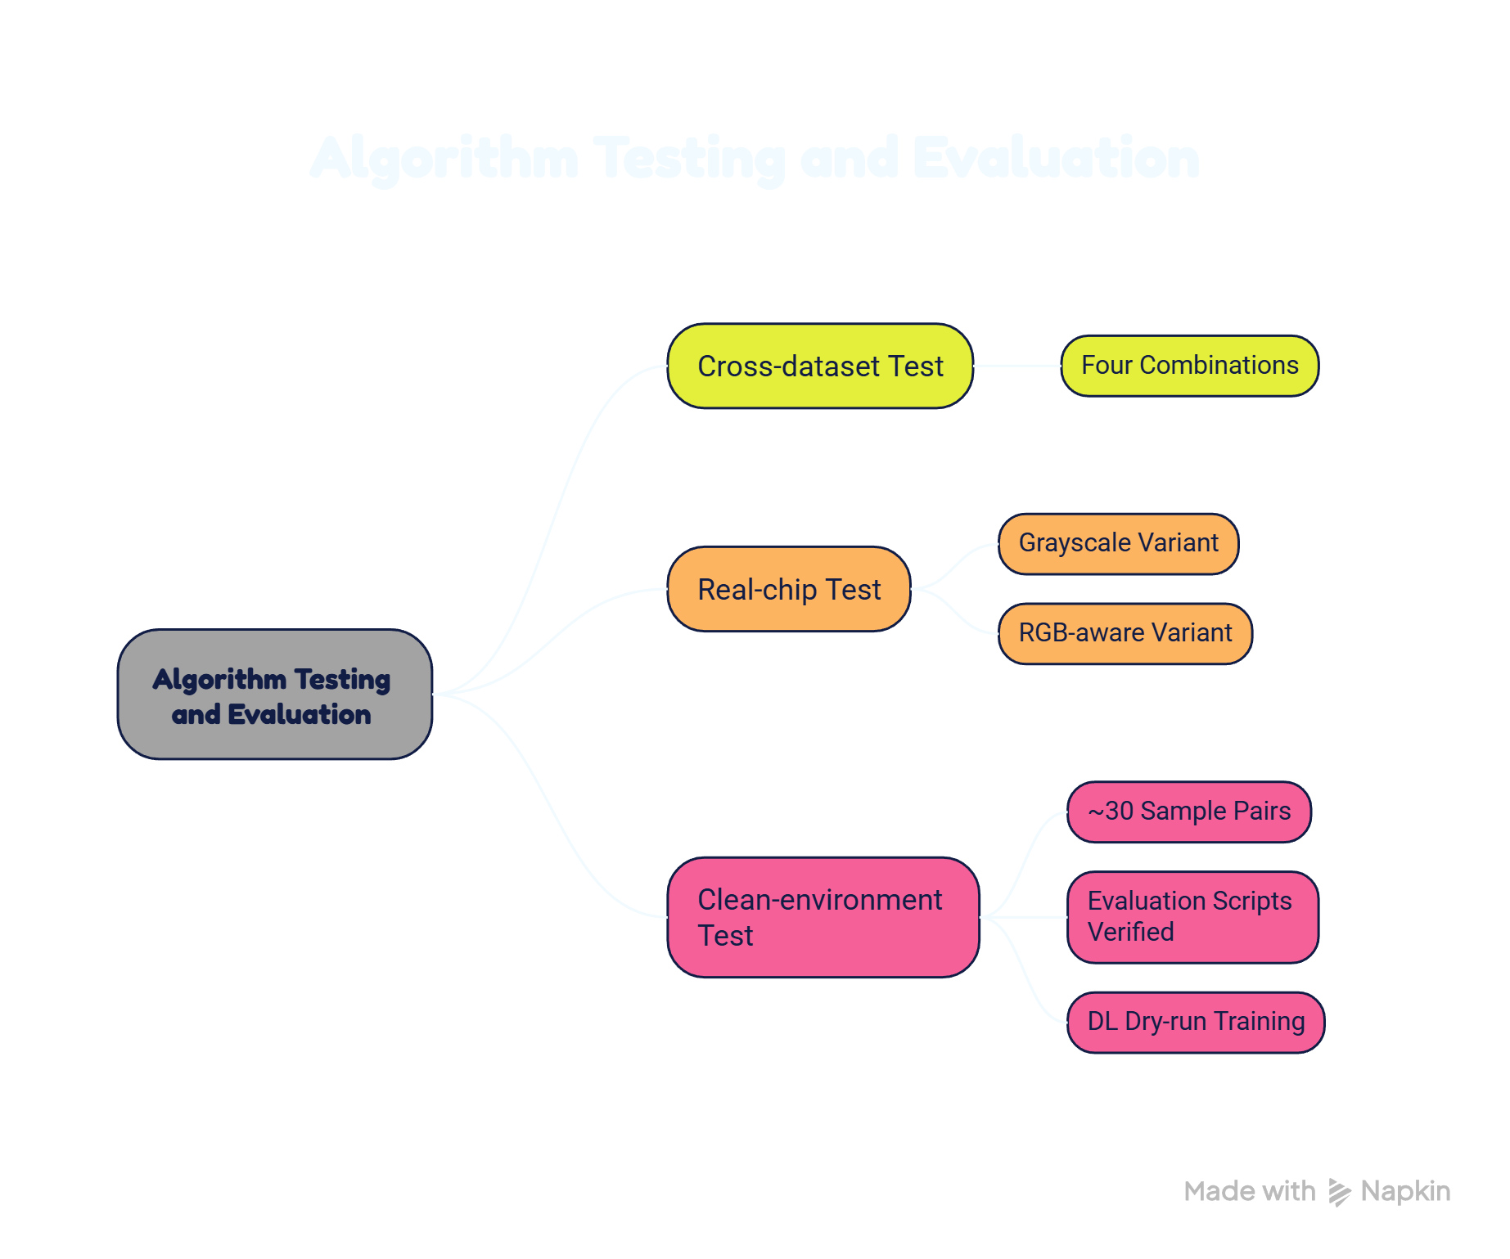
Experiment Setup and Test Diversity :

Slide 9
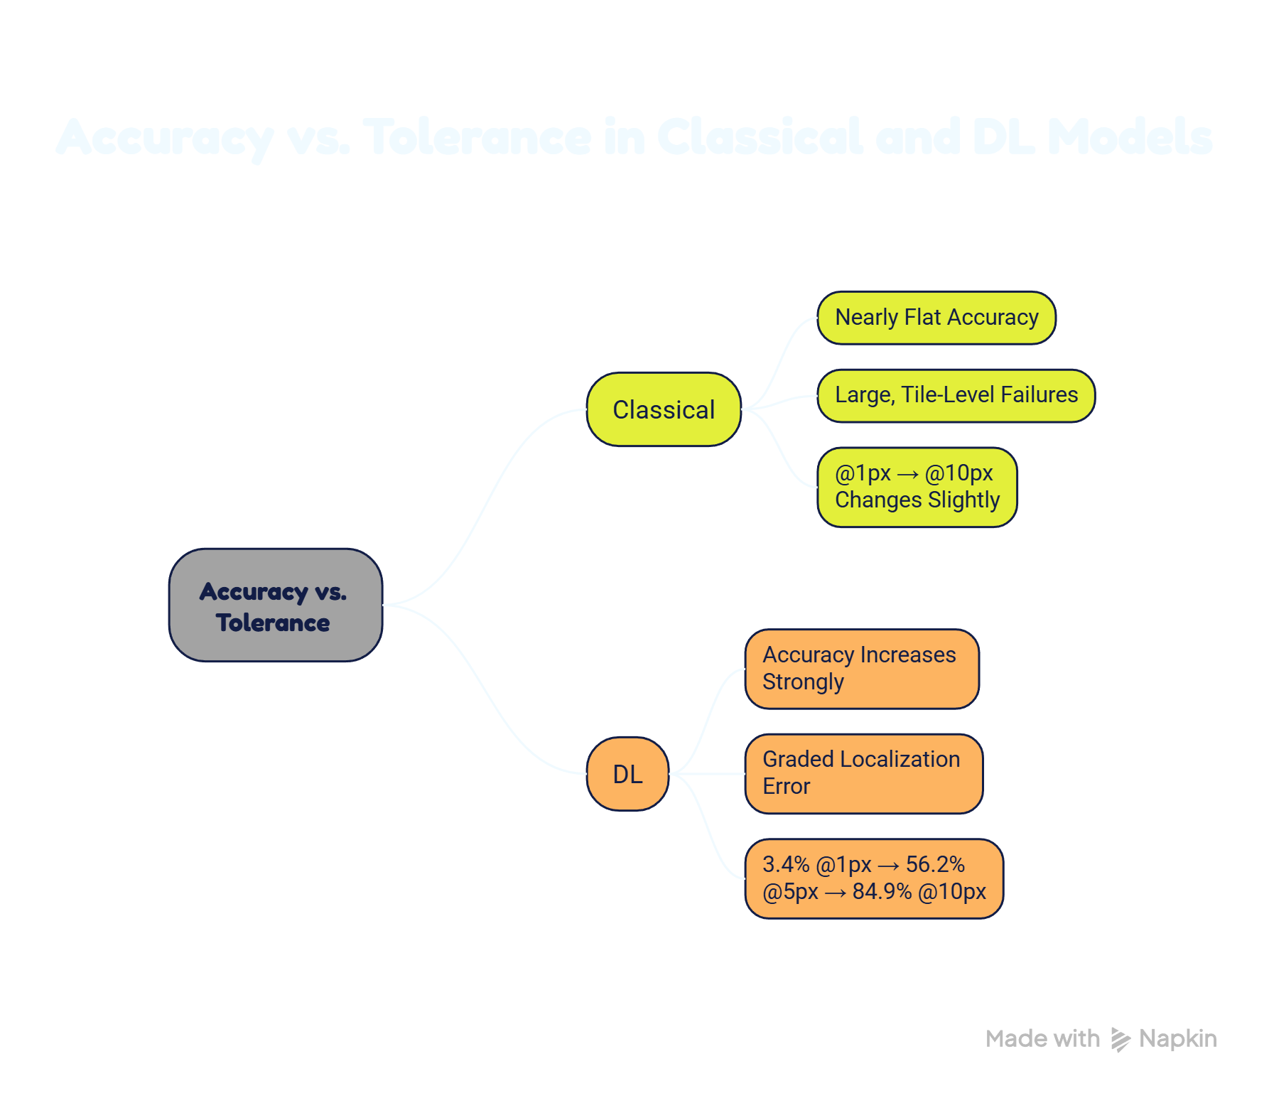
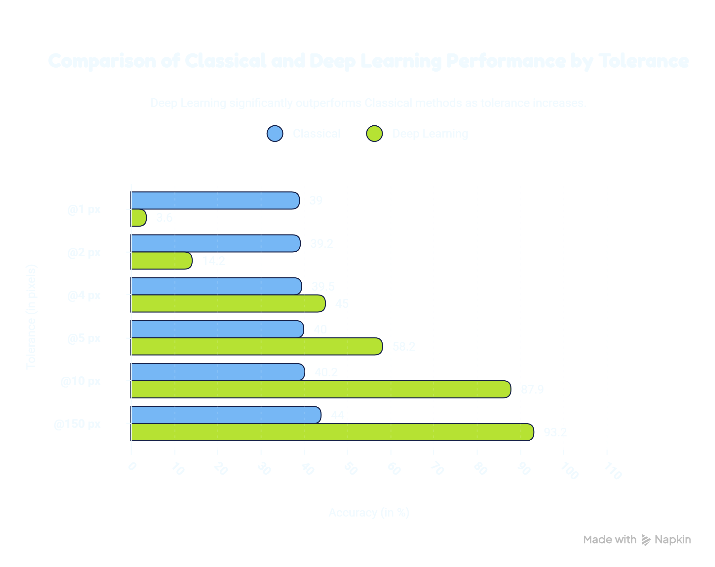
Threshold-wise Accuracy, Error Statistics and Run Time :
Main Conclusion :
DL provides both higher localization accuracy and lower inference time on the canonical defect-injected, variable-scale dataset.
3.6% @1px → 58.2% @5px → 87.9% @10px

Slide 10
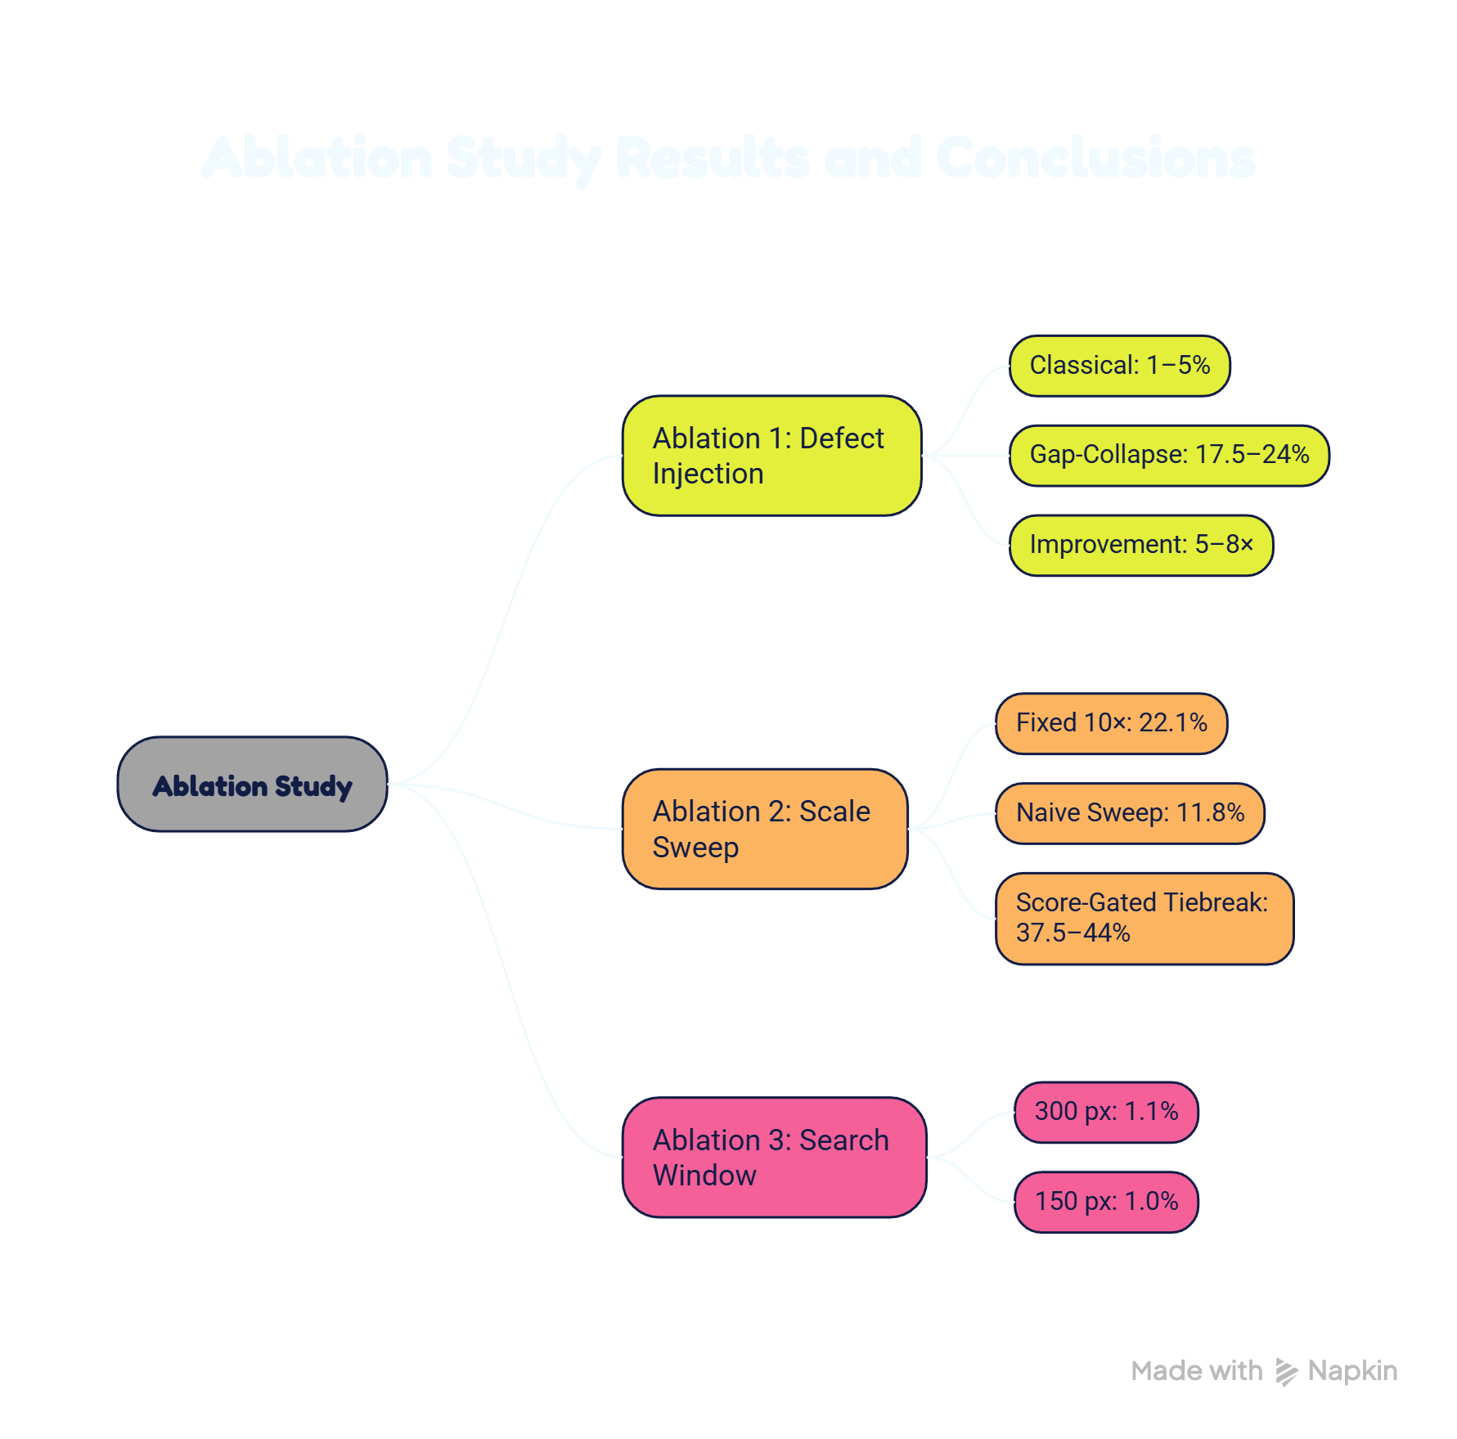
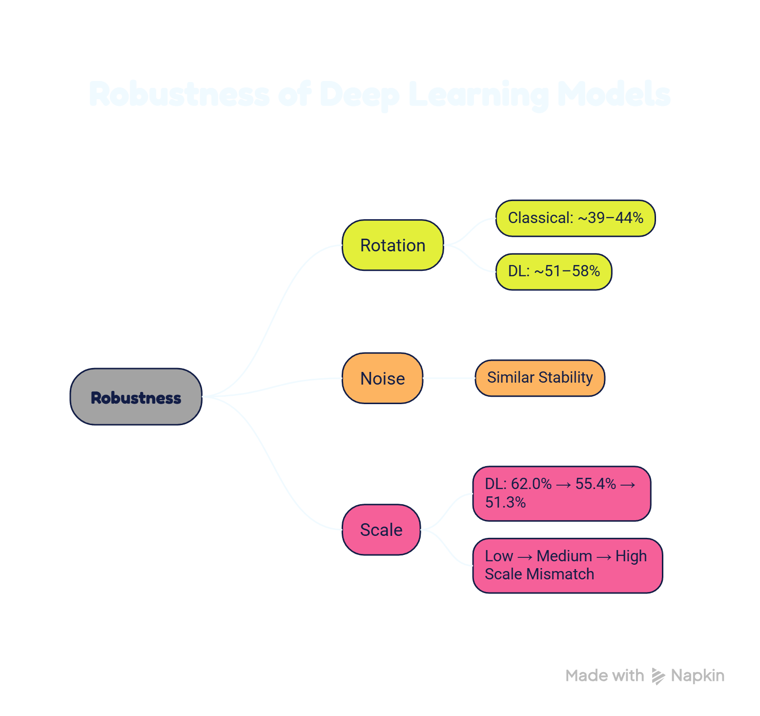
Robustness Comparison and Baseline/Ablation :
DL: ⁓56-60%
Breaking artificial perfect periodicity was the largest improvement.
DL : 59.8% → 57.7% → 57.3%
More search coverage does not automatically mean better localization; candidate-selection logic matters.
The dominant problem is not search-window size.

Slide 11
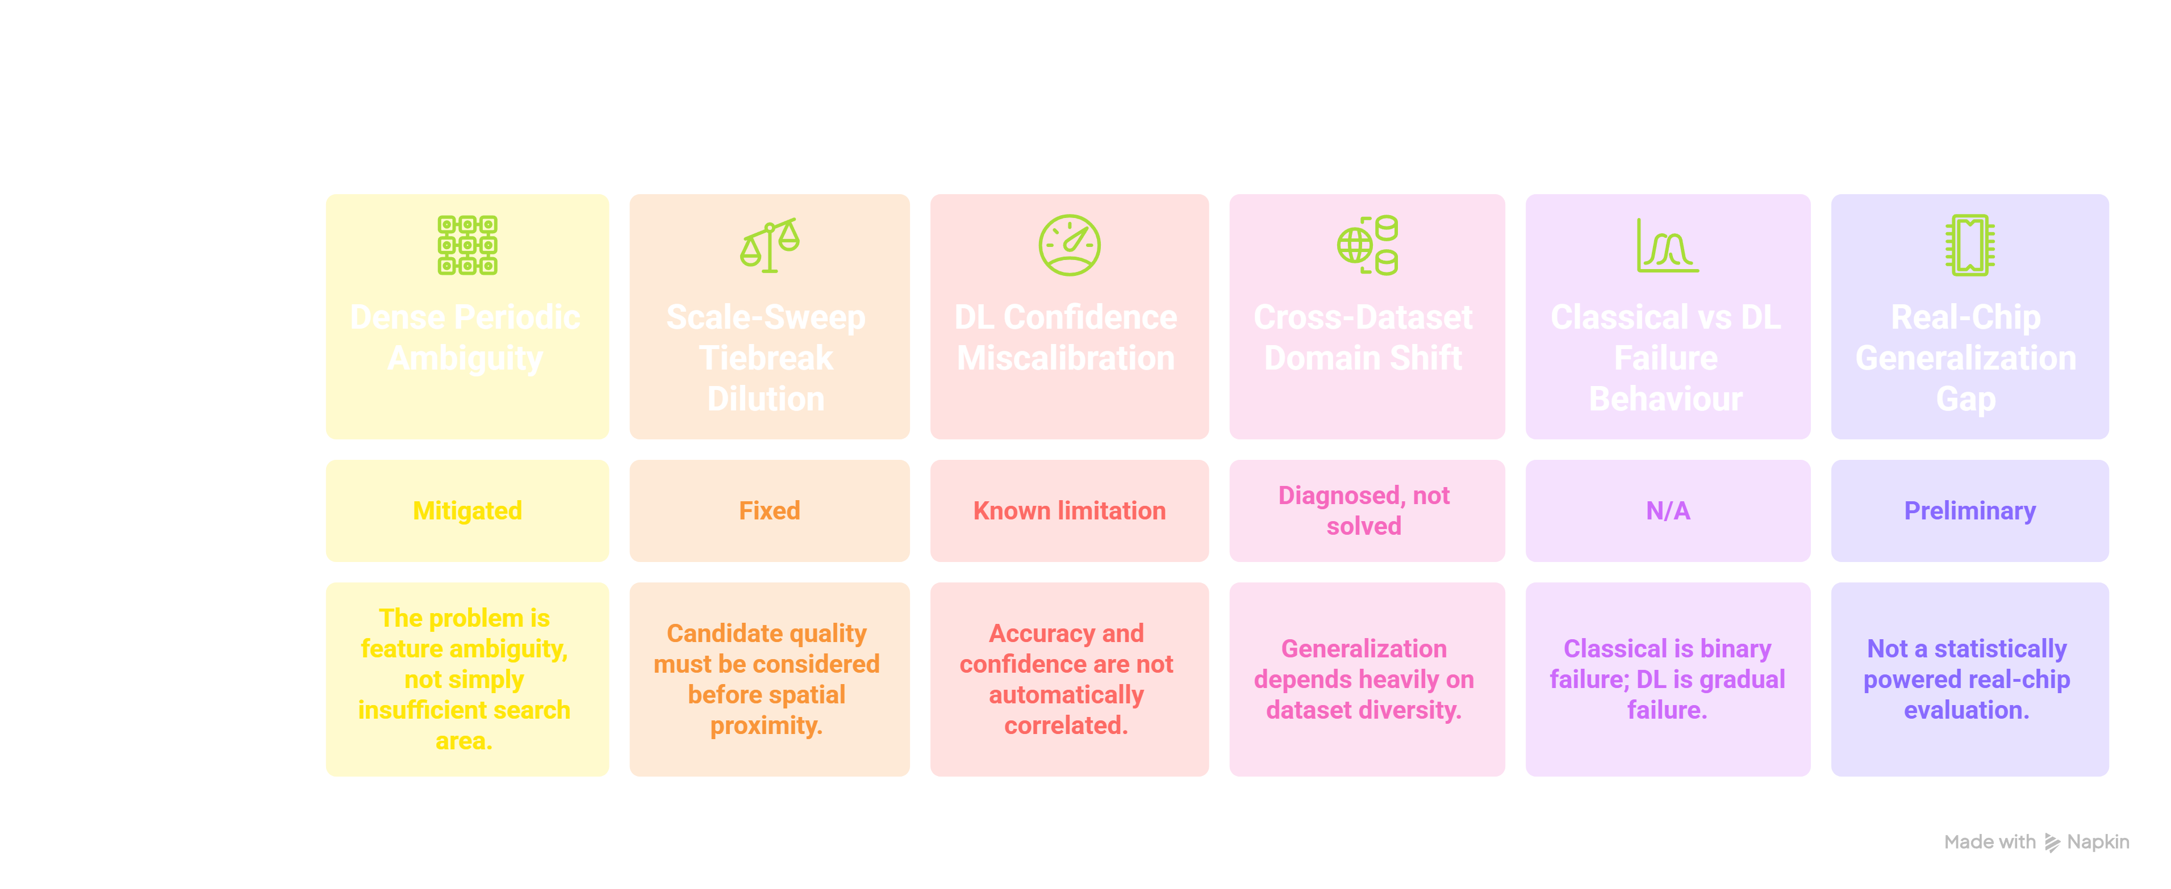
Failure Case, Limitation and Learning :

Slide 12
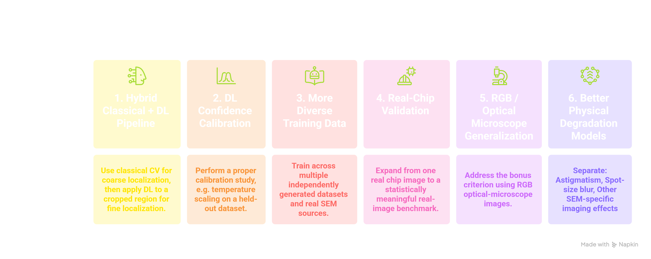




Conclusion, Next Steps, GitHub & Demo Video Link :
Conclusion :
What Drift-Sense demonstrated :
| Synthetic SEM-like data can be made substantially more useful by modelling realistic degradation and breaking perfect periodicity.
| Dense periodicity is the dominant localization challenge.
| Gap-collapse defect injection produced the largest improvement.
| Score-gated candidate selection solved the scale-sweep regression.
GitHub Repository
https://github.com/20251414005-ui/The-Nanoscale-Collective-Drift-Sense
Prototype / Simulation Video
https://youtu.be/J4DrD7h_Oh4

